Slide 1
Do Health Status and Mortality Causes Have a Correlation with Demographics and Location?
Spring 2019 - Business Analytics for Managers BYGB-7975-001
05/01/2019
TEAM WOLVERINE
Hayley Teng
Ila Srivastava
Katie Cao
Sravya Katta
Victoria Cleveland

Slide 2

Conduct an analysis of various causes of mortality, health status, and life expectancy among genders and education level in different countries over the years. Background Seek correlation and compare across location and demographics
Abstract
Introduction
Aged 65 and Older:
In 2010: 8% of population
In 2050: 16% of population (1.5 billion people)¹
Increasing life expectancy
Evolving diseases

Slide 3
How does mortality caused by various diseases and health status have an association with different gender/age groups globally?
Demographic factors and location play a big role in life expectancy and what diseases most commonly cause death in certain groups³ ⁴
Problem Statement
Rationale

Slide 4
Methodology: Diagram
Descriptive Analytics
Predictive Analytics
Formulate Hypotheses
Preprocess Dataset
Result + Share Insight
Recommendations
Statistical Model
Machine Learning
Using mortality rate of diseases to predict the life expectancy:
Multilinear Regression
Random Forest

Slide 5
Hypotheses and Rationale
Hypothesis 1: Males have a higher life expectancy compared to females, but this varies across different age groups.
Rationale: Using age as the control variable, life expectancy changes as one gets older. Males and females have different life expectancy ³
Hypothesis 2: Number of deaths caused by different diseases has a negative correlation with life expectancy
Rationale: The more people are expected to die from different diseases, the shorter the life expectancy they have
Hypothesis 3: Higher percentage of population with high education level positively correlates with higher life expectancy
Rationale: Using education level as the control variable, people are assumed to have more knowledge of how to maintain good health, therefore have higher life expectancy ²

Slide 6



Size: 5 years X 59 variables X 45 rows = 13,275
Type: Numerical data
Scale: Continuous
Number of Years: 8 years
Period: 2010 - 2017
Complete Web Link to Data: https://stats.oecd.org/Index.aspx?DataSetCode=HEALTH_STAT
Data
Tools Selection
Data Cleaning
Statistical Model
Descriptive Analytics
Predictive Analytics
Machine Learning Model

Slide 7
Independent Variables
Variable Name | Data Type | Data Scale | Example
Cause of Mortality | Nominal – Number of Death | 0 - 2000 | 43.2 cases per 100 000 population
Infant Mortality | Nominal – Number of Death | 0 - 100 | 33.6 deaths per 1 000 live births
Dependent Variables
Variable Name | Data Type | Data Scale | Example
Life Expectancy | Nominal – Number of Years | 0 - 100 | 84 years old
Health Status | Nominal – Percentage of Population | 0 - 100 | 69.8% of population with Good/Very Good Health Status with age 15+
Control Variables
Age
Education Level
Measurement of Independent Variables: Per 100 000 population, Per 1000 live births

Slide 8
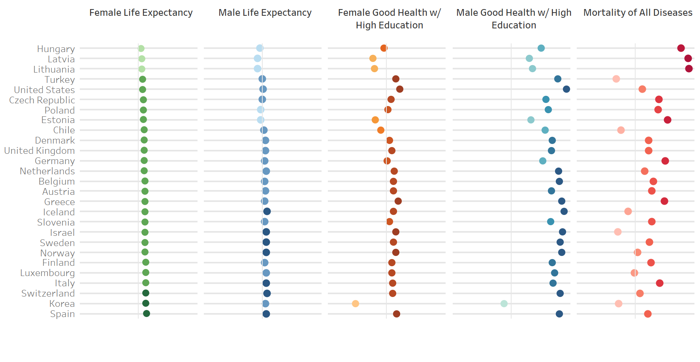
Figure 1: Snapshot of OECD Countries Health Status

Slide 9
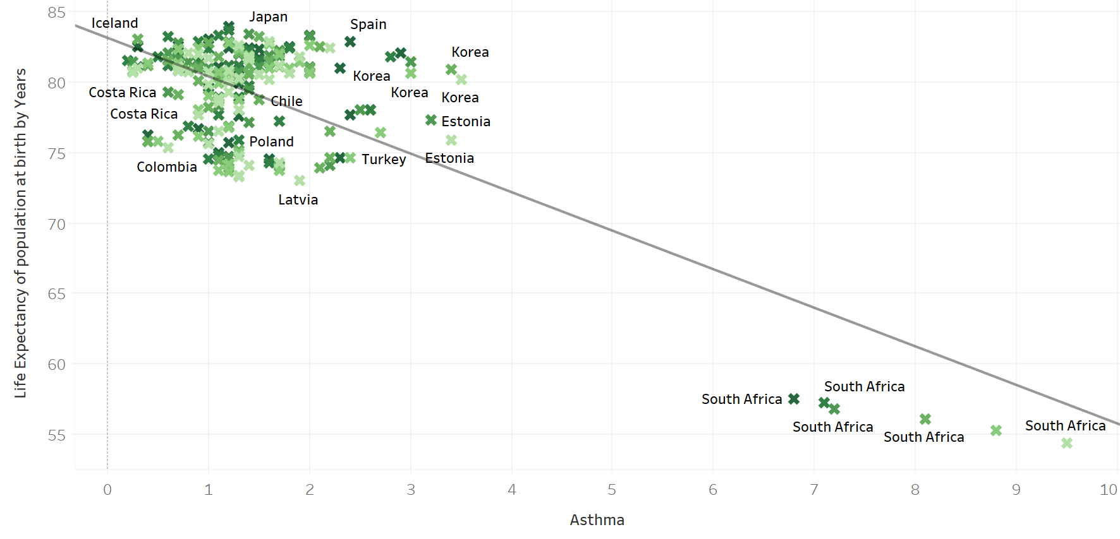
Asthma Mortality Predict Life Expectancy
Figure 2: Scatter plot with the linear trend line of Asthma Mortality (# of deaths) predicting Life Expectancy of total Population at Birth (by Years)

Slide 10
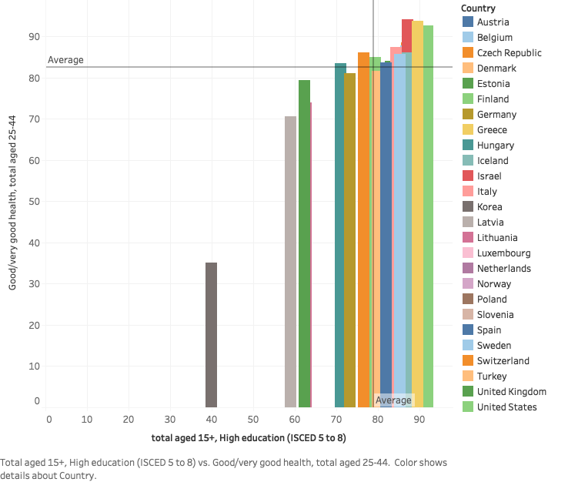
Health Status - Education
Figure 3: Dual combination chart showing the association between average health status expectancy of 25 – 44 years old with good health and education level globally

Slide 11
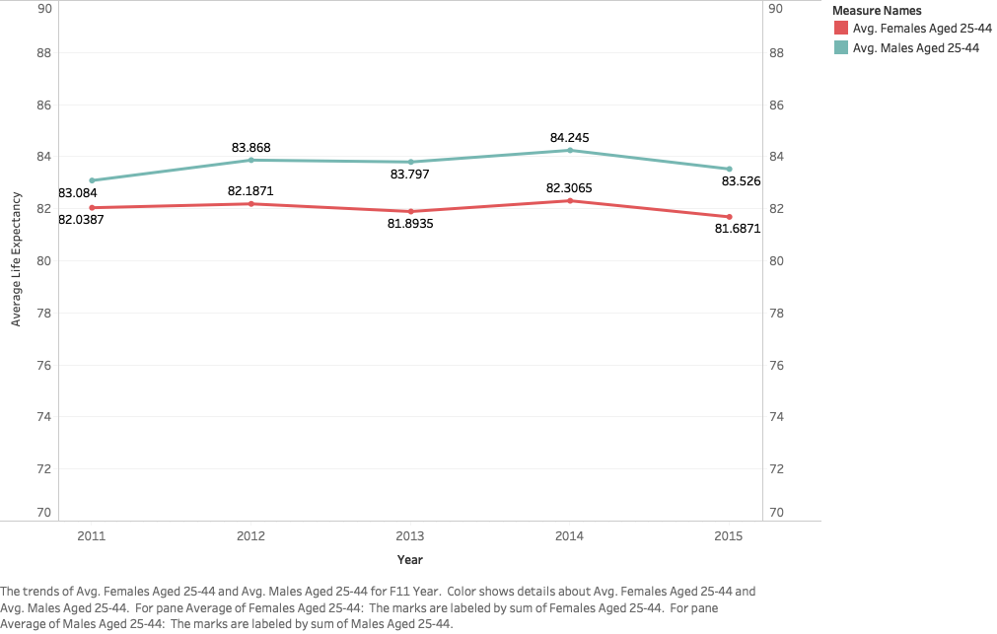
Average Life Expectancy by Gender
Figure 4: Line chart detailing a comparison of the change in average life expectancy over time of male and female 25-44 years old across the globe.
Notes:
Victoria

Slide 12
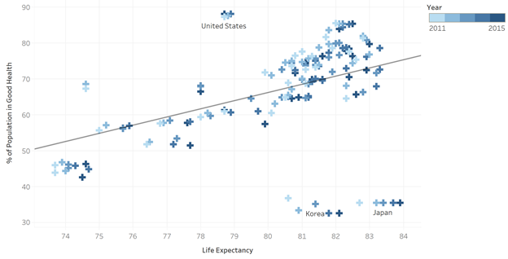
Predicting life expectancy at birth using percentage of population in good health, 2011-2015
Figure 5: Scatter plot with the linear trend line of predicting life expectancy at birth using percentage of population in good health, 2011-2015

Slide 13
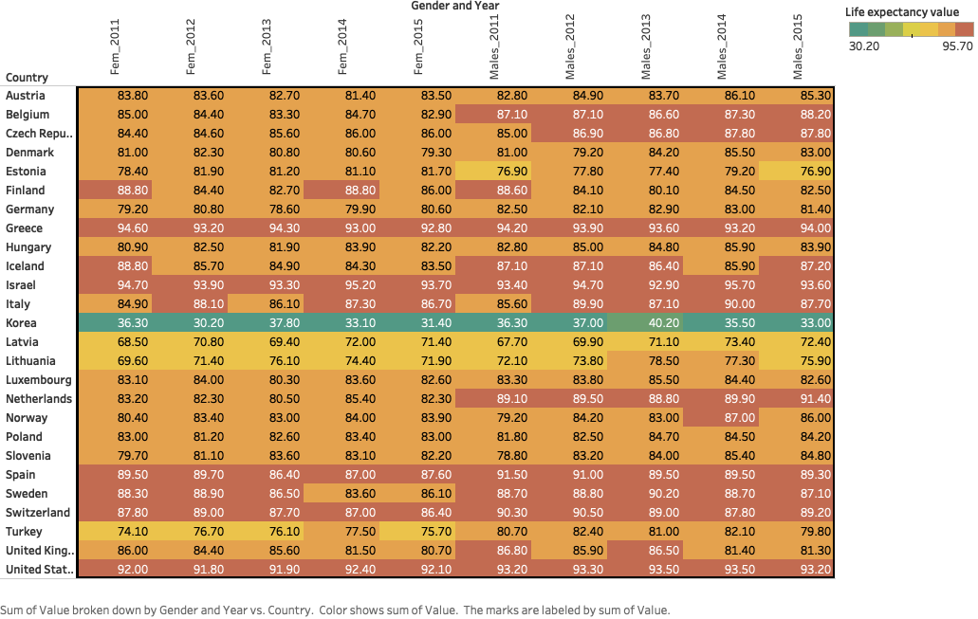
Life Expectancy vs Location
Figure 6: Heat map detailing life expectancy over time of 25-44 year old males and females across all the locations

Slide 14
Key Results
Higher % of educated citizens -> higher overall health status
Men have a higher life expectancy compared to women
% of the population in good health correlates with higher life expectancy
Average life expectancy went up over the years in both genders
Scope and Limitations
Research is restricted to certain diseases
Missing recent year data for certain variables and countries

Slide 15
Conclusion and Future Research
Awareness among gender and age groups
Importance of education and income levels on an individual life expectancy
Scope for broader research
Drilling down further to cities to explore people’s health status
Analyze contributing factors like lifestyle
Policy Recommendation
Government policy and education program on female population of diseases with high mortality rate, including:
1) Malignant Neoplasms of Trachea, Bronchus and Lung and
2) Ischaemic Heart Disease
Increase high education female population

Slide 16
References
Global Health and Aging. World Health Organization, Oct. 2011, www.who.int/ageing/publications/global_health.pdf.
Meara, E. R., Richards, S., & Cutler, D. M. (2008). The gap gets bigger: changes in mortality and life expectancy, by education, 1981–2000. Health Affairs, 27(2), 350-360.
Keeler, E., Guralnik, J. M., Tian, H., Wallace, R. B., & Reuben, D. B. (2010). The impact of functional status on life expectancy in older persons. Journals of Gerontology Series A: Biomedical Sciences and Medical Sciences, 65(7), 727-733.
Singh, G. K., & Siahpush, M. (2014). Widening rural–urban disparities in life expectancy, US, 1969–2009. American journal of preventive medicine, 46(2), e19-e29.

